Slide 1

Web Development Foundations
08
Project Planning

Slide 2
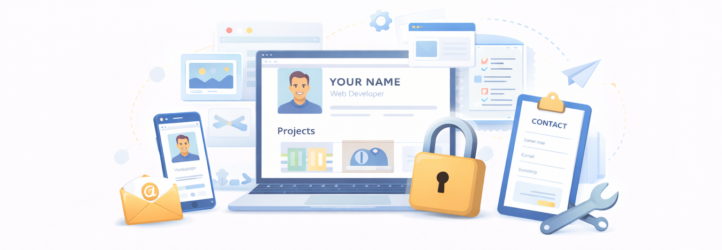
Part 1: The Portfolio
The capstone of this course is the creation, optimization, and deployment of your Professional Developer Portfolio. This multi-page responsive website will showcase your technical skills, the projects you've built and provide a way for potential employers or clients to contact you.

Slide 3
Technical Requirements
01
Multi-Page Layout: At least three distinct pages (e.g., Home, Projects, About/Contact).
Global Navigation: A consistent, responsive navbar across all pages
Responsive Grid: A project gallery that adjusts its columns based on screen size
Custom Styling: A cohesive color palette and typography system (no default browser styles).
Structure & Design (The HTML/CSS Pillar)
02
Dynamic Gallery: Projects must be rendered from a data source
Asynchronous Integration: At least one component must use fetch() to pull data (e.g., displaying your GitHub repositories or weather data).
Form Validation: The contact form must validate user input before "submission."
Interactivity & Data (The JavaScript Pillar)
03
Version Control: A clean GitHub repository with a minimum of 10 meaningful commits.
Documentation: A README.md file explaining the project, technologies used, and how to run it locally.
Live Hosting: Successful deployment to Vercel with a live URL
Deployment & Workflow (The Professional Pillar)

Slide 4
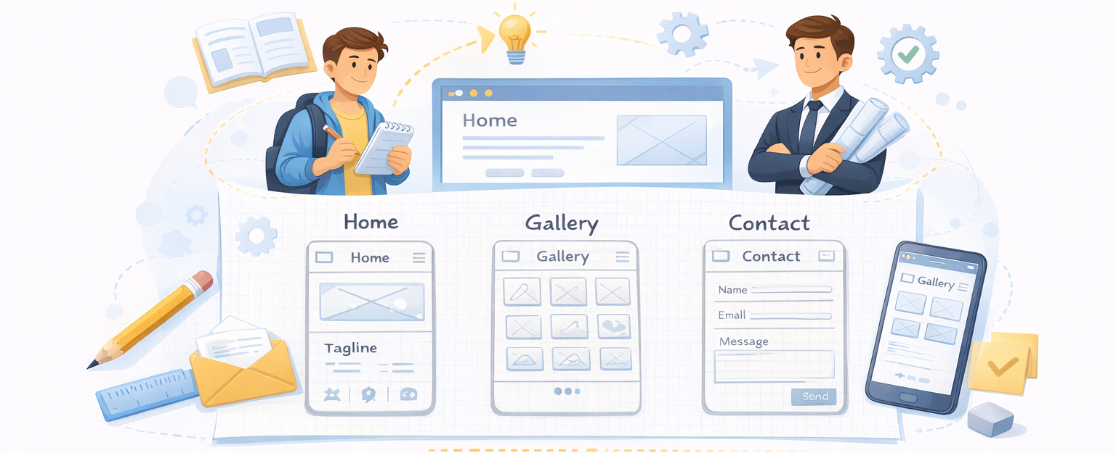
Wireframing
Low-fidelity sketching of the 3-page journey (e.g; Home, Gallery, Contact).
Focus on the "Mobile-First" layout.

Slide 5
Sprint Planning
Initialize your final Project Repository in github
Preferably <username>.github.io
Translate the technical brief into 6-8 GitHub Issues
Examples to be provided
No coding is permitted until the Board is set up
Plan CSS system (colors, spacing) to ensure consistency across all the pages

Slide 6
Part 2: The Shell
Goal: Build the structural foundation and secure the Live URL.
Multi-Page Setup: Creation of index.html and other required files
Shared Components: Building the Responsive Navigation and Footer.
Requirement: The Navigation must be identical and functional on all pages.
Integration: Connecting the GitHub repo to Vercel or setup GitHub pages
Success Metric: Every student ends this hour with a live (though empty) URL.
Atomic Commits: Practice using keywords like Closes #1 in commit messages to automate their GitHub board.

Slide 7
10
Minute Break

Slide 8
Part 3: Functionality Guide
Fetch data from an external API and dynamically render them on screen
Option A | Custom json data, e.g; projects data from Assignment #2 https://magnetikworks.github.io/project-data/data/projects.json
Option B | Use data from Social: https://jsonplaceholder.typicode.com/
Option C | Use Dynamic data: e.g; Current weather https://openweathermap.org/api *
*OpenWeatherMap requires an API key.
Hence recommended to deploy into Vercel or Netlify and specify it as an env variable for security

Slide 9
Dynamic Integration
Interactive Search/Filter:
Re-implementing the Assignment 2 logic to work with the live GitHub data.
Form Logic & Validation:
Build the Contact page logic using e.preventDefault() and custom email validation.

Slide 10
Summary
1. Management (GitHub Issues)
Break the brief into tickets. Use labels (feature, bug).
Link commits to issues using Closes #X.
2. Structure (HTML/CSS)
3 Pages + Responsive Navbar + Shared CSS Variables.
Mobile-First design using Grid or Flexbox.
3. Intelligence (JavaScript)
Fetch API: Pull live data from GitHub.
Form Logic: Validate inputs and provide user feedback.
4. Delivery
Continuous Deployment: Push to GitHub = Live Update.
Professional README.md documented for recruiters.

